Slide 1
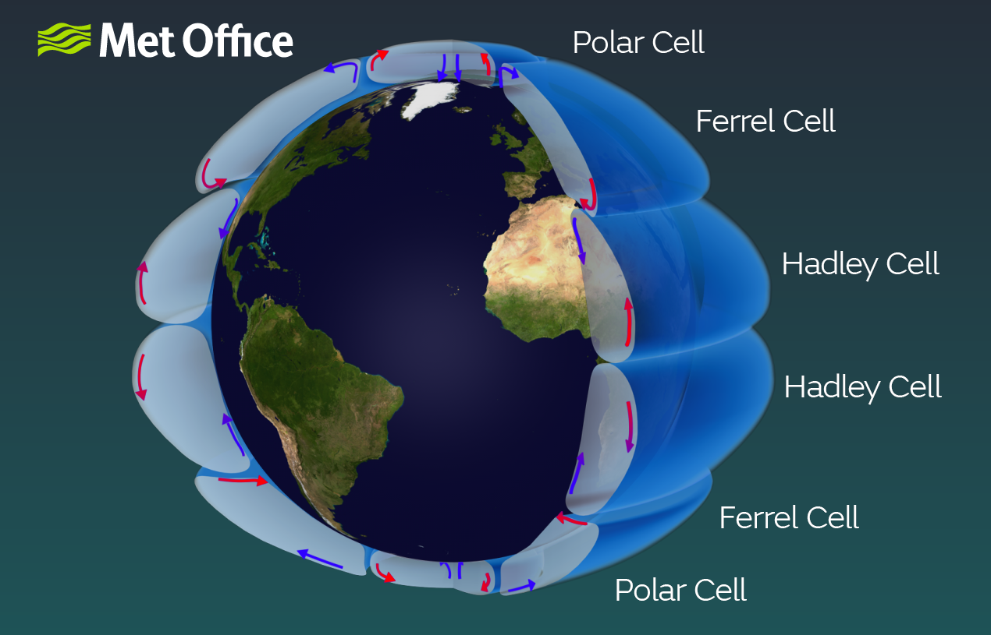

Polar, Ferrel, and Hadley cells
The vertical structure shown here is highly exaggerated

Slide 2
Polar, Ferrel, and Hadley cells
Uplift zones
Rising air tends to make cloudy skies, storms, and wet climates.
Subsidence zones
Descending air tends to make clear skies and dry climates.

Slide 3
Poleward shift of these zones
What seems to be happening is a poleward shift of the Ferrel/Hadley subsidence zones (the shift is shown with arrows).
There’s also an intensification of all of the zones (more vigorous subsidence, more vigorous uplift)

Slide 4
Think-pair-share about perceptions of climate change for somebody who lives near a cell boundary
Example 1: Suppose you live in a location just poleward a pre-industrial subsidence center (“x”, like Santiago, Chile). Given that subsidence is associated with dry, hot (desert-like) conditions, what’s your prediction? (Hint: this is a shift question.)
Example 2: Suppose you live in a pre-industrial uplift center (“y”). What’s your prediction? (Hint: this is an intensification question.)
y
x
x
x

